Slide 1
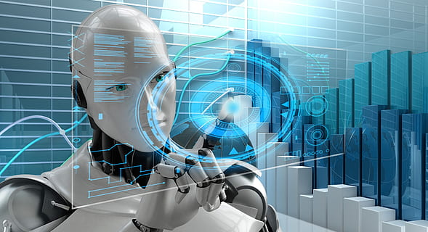
Analysing Facebook Video Views - Charity Organization
Rashikh Shaik
Data Analyst/Data Engineer/Data Scientist
skrashikh@yahoo.com

Slide 2
Contents
Biography: Introduction about myself
Data Science and ML for Nonprofit Organisations
Business Question
Data Science Process
Challenges
About Data
Feature Description
Exploratory Data Analysis
Clustering
K-means Clustering
Elbow Method
Analysis on each Cluster
Classification Algorithms
LightGBM Classifier
Conclusion

Slide 3

Biography
Education
Master of Technology, Computers.
Bachelor degree in Information technology.
Professional Education
Data Scientist – Institute of Data - RMIT
Microsoft Certified professional
MCP: Implementing a Data Warehouse with Microsoft SQL Server 2012
MCP: Implementing Data Models and Reports with Microsoft SQL Server
Professional Experience
6+ years of experience in ETL and BI tools such as Informatica, MSBI, Tableau, PowerBI.
Experienced in Cloud technologies like Azure Data Factory

Slide 4
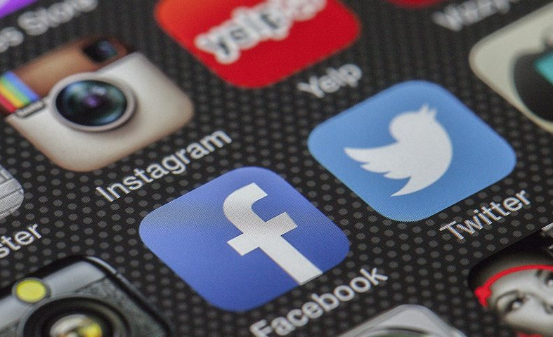

Data Science and ML for Nonprofit Organization's
Nonprofits can use analytics to boost their fundraising efforts, measure and monitor the impact of their activities, build predictive models, optimize allocation of funds, and more
1. Marketing and fundraising
2. Monitoring and implementing specific activities
3. Streamline funds
This Photo by Unknown author is licensed under CC BY-NC.

Slide 5

Business Question
Build a social content strategy for targeting gender and age group and understand the engagement between them.

Slide 6
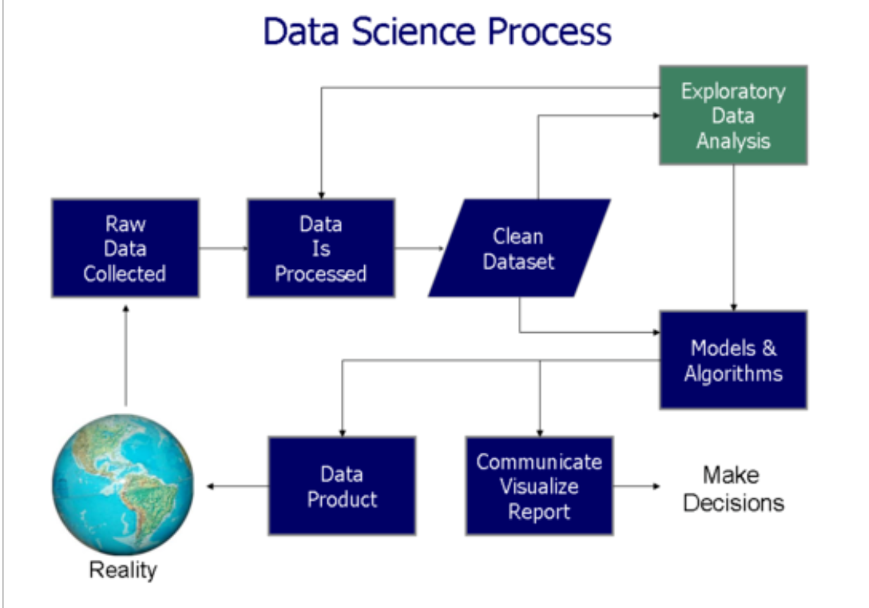

Slide 7
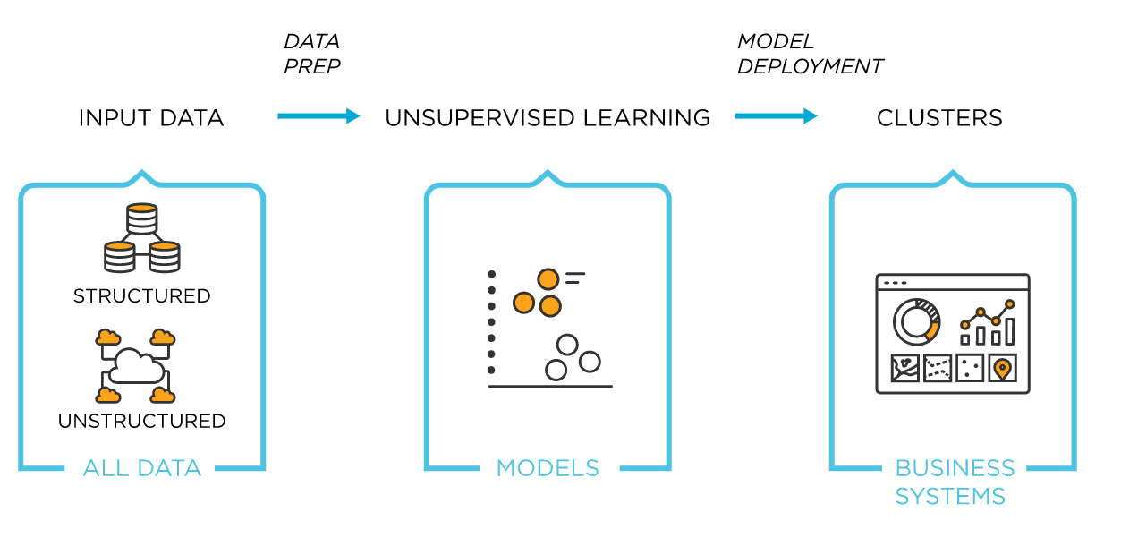
Challenges : Unsupervised Learning

Slide 8
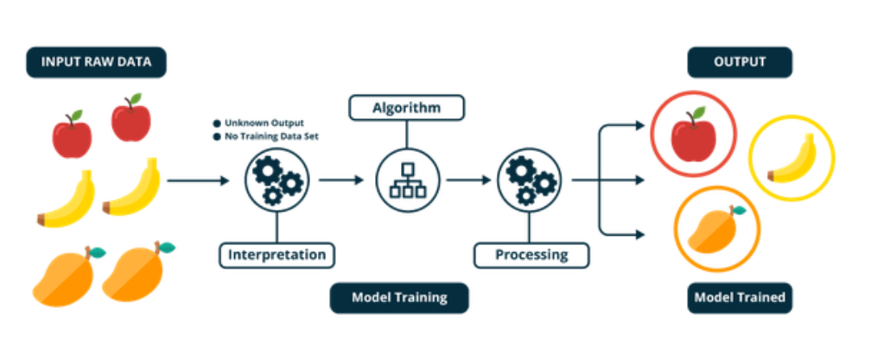
Unsupervised Learning

Slide 9
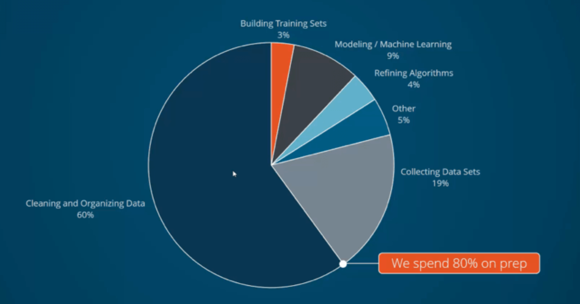

Slide 10
About Data
Data is collected from one of the charity organization.
It contains Facebook video views with video titles, gender and age group.
Data is Unsupervised.
It's a 90 days of data – 19th April 2021 to 17th July 2021.
Total number of records : 572
Number of features : 228
228 features are labelled to 4 features and transform the unsupervised learning into cluster data.

Slide 11
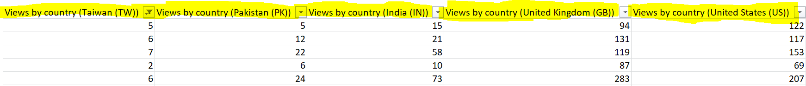
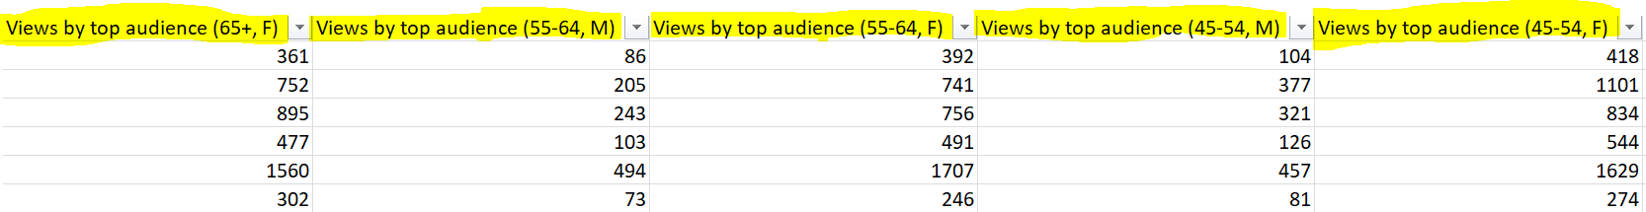

Sample data
Unsupervised:

Slide 12
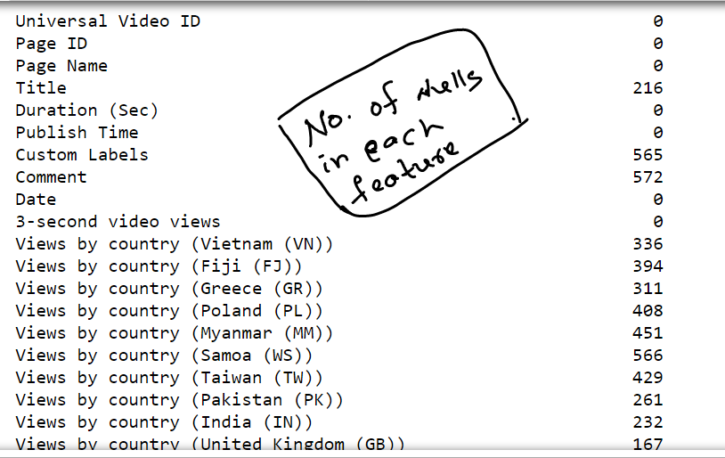
Challenges - Dataset is balanced? Nulls?

Slide 13
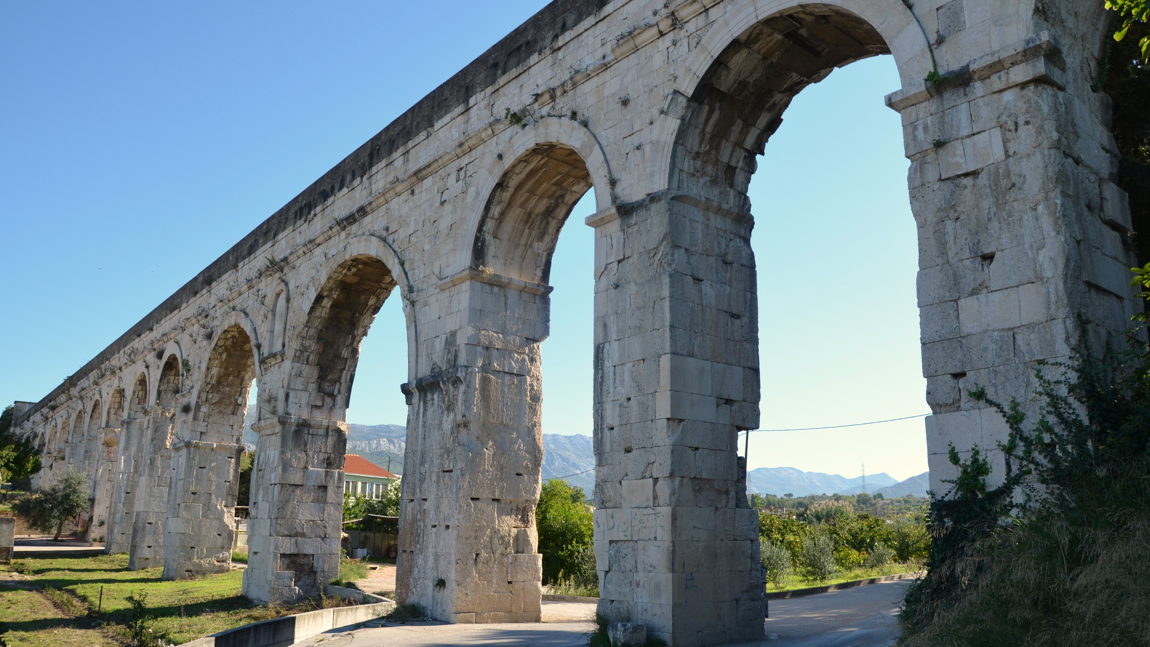
Feature Description
Gender
Male
Female
AgeGroup ( 7 splits)
13 – 17
18 – 24
25 – 34
35 – 44
45 – 54
55 – 64
65+

Slide 14
Feature Description
Video Titles (13 Categories)
COVID-19
Stories of Hope
Volunteers
Disaster
Humanity/Kindness
Charity Campaigns
Speakers
Extension of Organization Support
Indigenous
Educational Videos
Help/Support
Others
Each Title category has respective videos.(Ex: Humanity/Kindness - Super Granny)

Slide 15
Challenges - Dataset is balanced? Nulls?
Gender | Count Of Records
Female | 1225
Male | 1180
Title Categories | Count Of Records
Stories of Hope | 241
Disaster | 228
Help/Support | 227
COVID-19 | 205
Educational Videos | 202
Charity Campaigns | 178
Extension of Charity Organization Support | 148
Humanity/Kindness | 134
Others | 78
Speakers | 70
Volunteers | 52
Indigenous | 41
AgeGroup | Count Of Records
13 - 17 | 223
18 - 24 | 361
25 - 34 | 369
35 - 44 | 368
45 - 54 | 363
55 - 64 | 358
65+ | 363

Slide 16
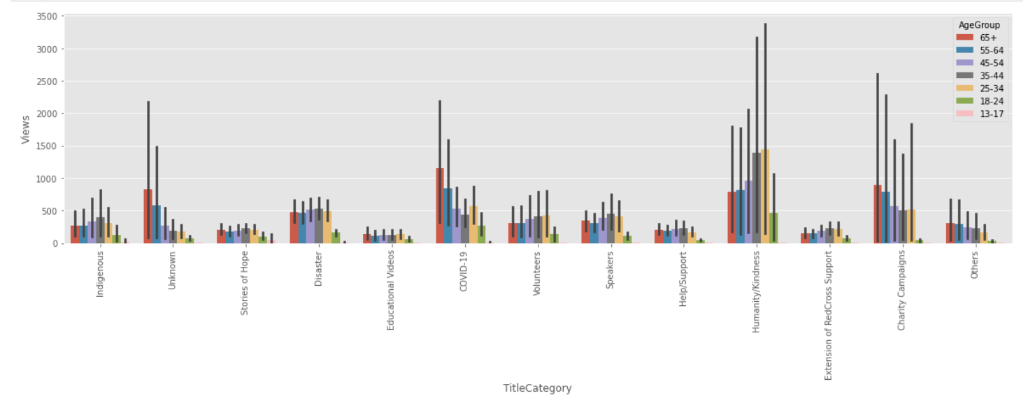
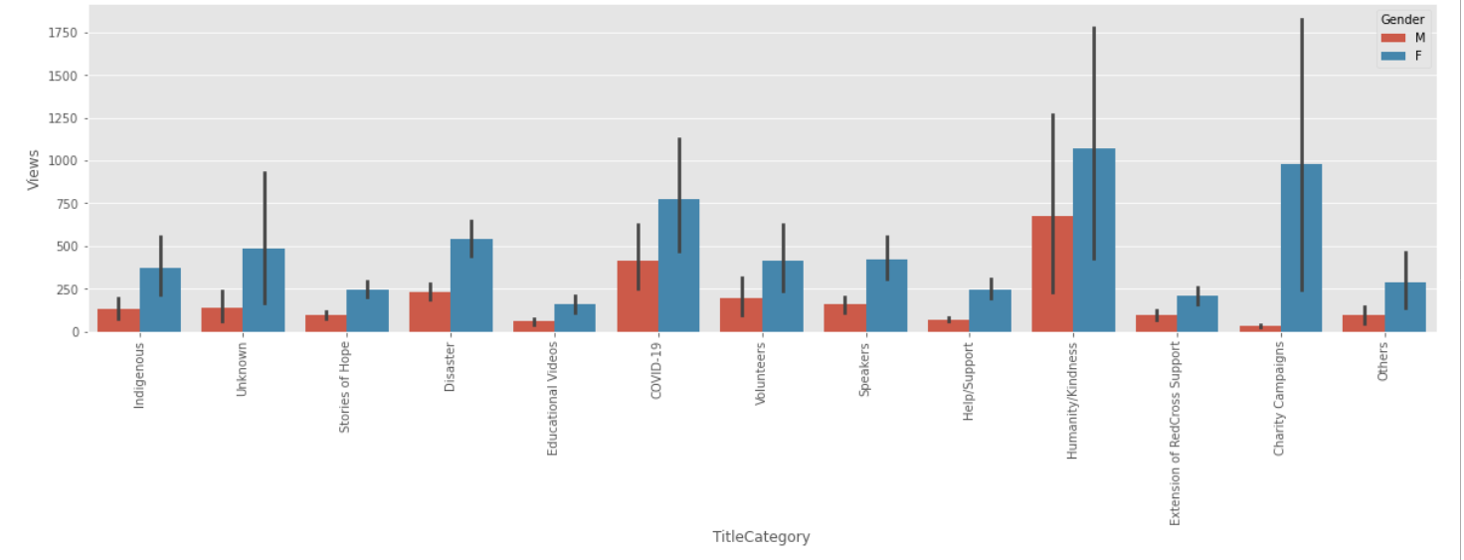
EDA
Female % was more for video views when compared to male.
The top 4 video groups with AgeGroup are:
Humanity/Kindness(25-34)
Covid-19(65+)
Charity Campaigns(65+)
Disaster(35-44)

Slide 17
Clustering
OneHotEncoder:
TitleCategory
AgeGroup
Gender
K-means Clustering
Elbow Method

Slide 18
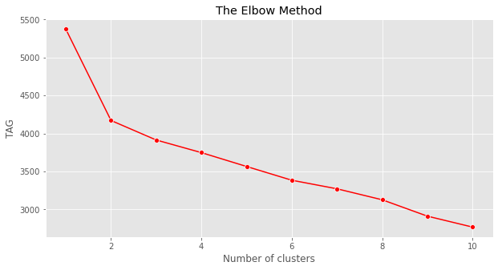
K-means Clustering
Elbow Method For Optimal k
K =3 clusters

Slide 19
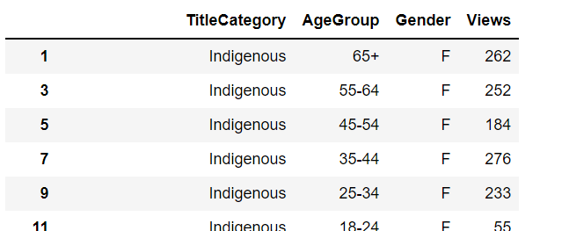
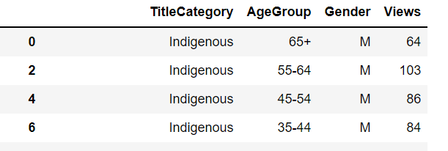
Clusters
K = 3
Cluster 1: Male
Cluster 2: Female
Cluster 3: Unknown(not enough data)

Slide 20
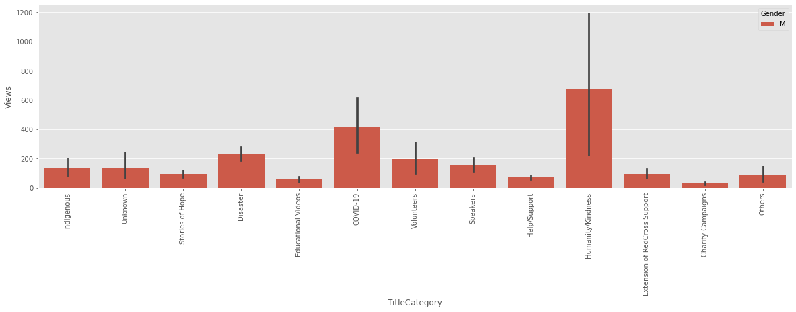
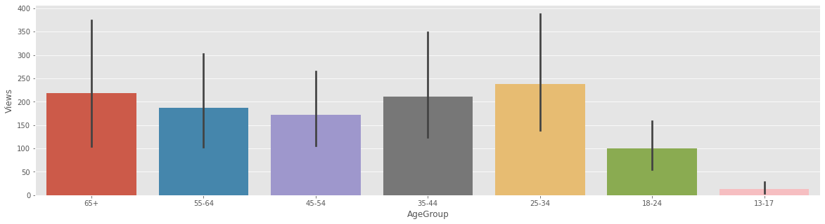
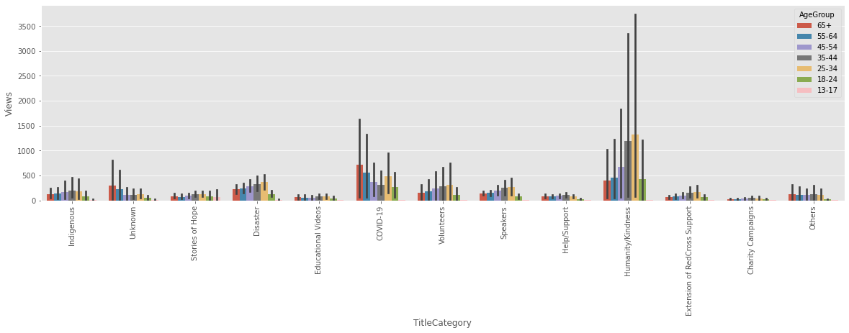
Cluster 1Analysis (Male): Humanity/Kindness (25-34 Age group)

Slide 21
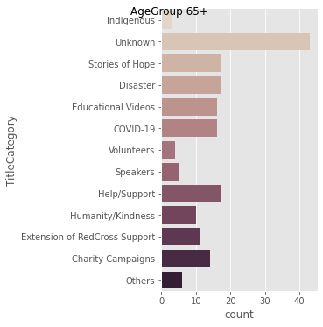
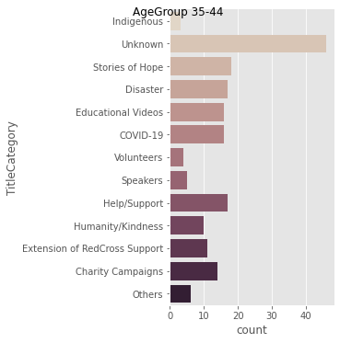


Cluster 1: (Male) Age Groups:
65+ : Disaster
55-64 : Stories of Hope
45-54 : Stories of Hope
35-44 : Stories of Hope

Slide 22
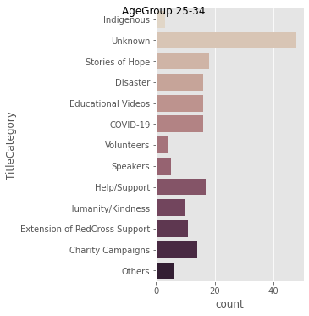
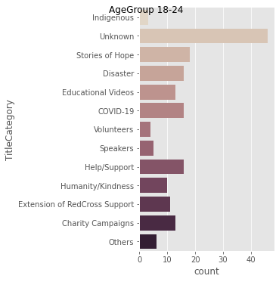
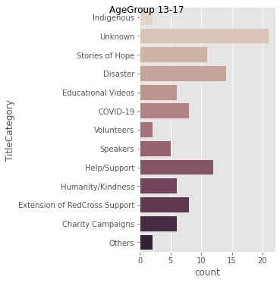
Cluster 1: (Male) Age Groups:
25-34 : Stories of Hope
18-24 : Stories of Hope
13-17 : Disaster

Slide 23
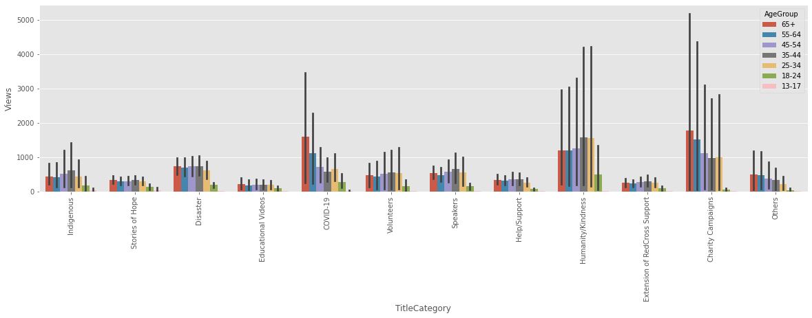
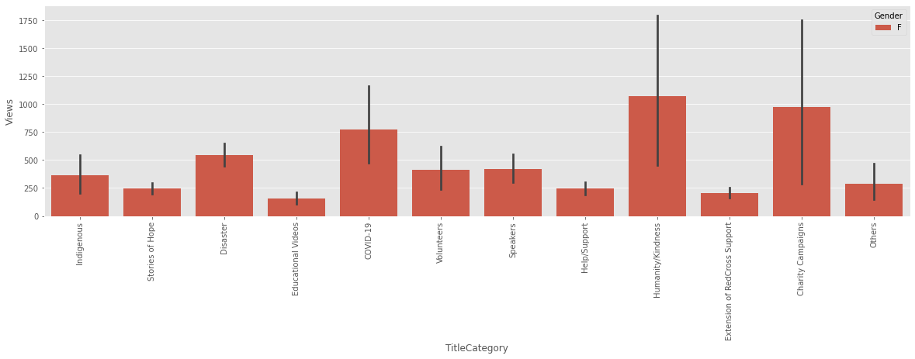
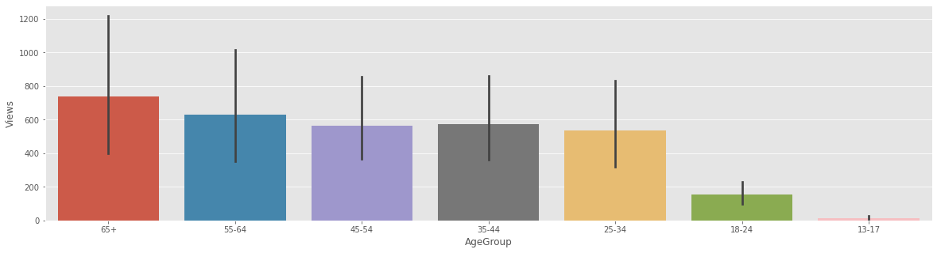
Cluster 2 Analysis (Female):
65+ has more video views
Charity Campaigns
Humanity/Kindness

Slide 24
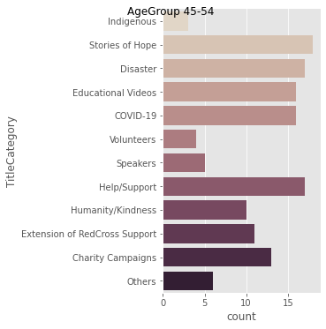



Cluster 2 Analysis (Female): Age Groups
65+ : Stories of Hope
55-64 : Stories of Hope
45-54 : Stories of Hope
35-44 : Stories of Hope

Slide 25

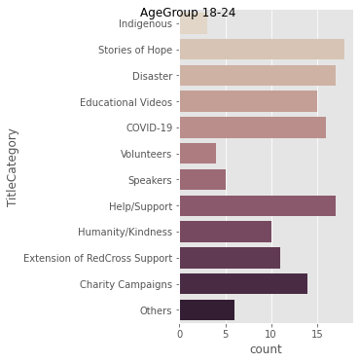
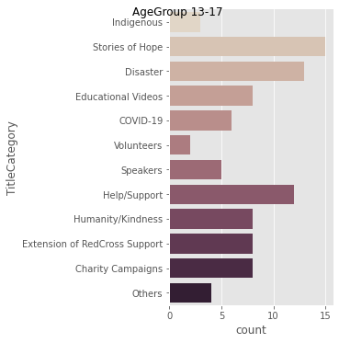
Cluster 2 Analysis (Female): Age Groups
25-34 : Stories of Hope
18-24 : Stories of Hope, Help & Support
13-17 : Stories of Hope
This is 2021 data and in this pandemic people are more interested to watch hope and support videos irrespective of gender and age group.

Slide 26
Classification Algorithms
LightGBM Classifier:
LightGBM Model accuracy score: 1.0
Training-set accuracy score: 1.0
Check for Overfitting:
Training set score: 1.0
Test set score: 1.0

Slide 27
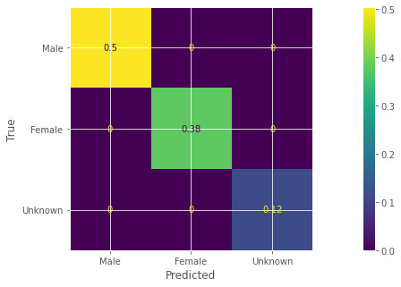
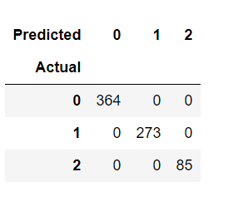
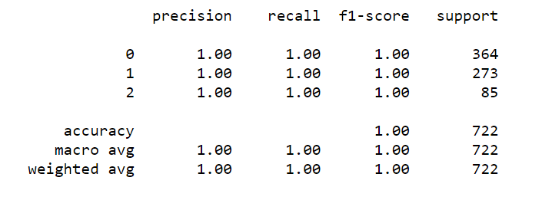
LightGBM Classifier
Confusion-matrix
True Positives(TP) = 364
True Negatives(TN) = 273
False Positives(FP) = 0
False Negatives(FN) = 0
Classification Metrices
Precision = 1
Recall = 1
F1–score = 1

Slide 28
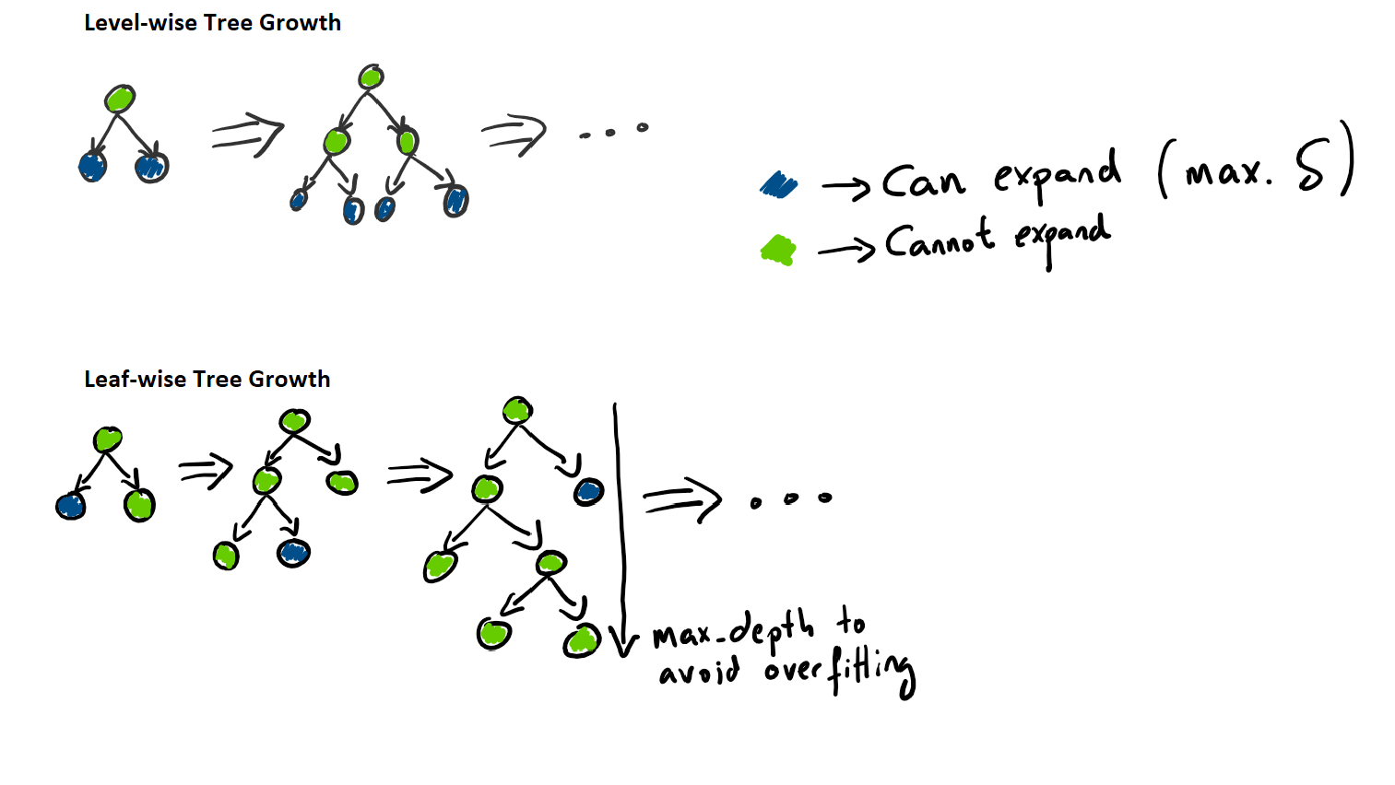
Reason to choose LightGBM
LightGBM is a gradient boosting framework that uses tree-based learning algorithms. It is designed to be distributed and efficient with the following advantages:
Faster training speed and higher efficiency.
Lower memory usage.
Better accuracy.
Support of parallel and GPU learning.
Capable of handling large-scale data.
Light GBM is so popular is because it focuses on accuracy of results.
LGBM also supports GPU learning and thus data scientists are widely using LGBM for data science application development.
It is not advisable to use LGBM on small datasets. Light GBM is sensitive to overfitting and can easily overfit small data.

Slide 29
Conclusion
The accuracy is 100%, which could be due to 90 days of dataset.
LightGBM gives best accuracy without Overfitting.
By using this model If any new user comes, we can identify in which cluster they belongs, and we can identify their behaviors.
This model will help nonprofit organizations to reach users based on their behavior and this may also help in increasing fund raising.
Future Work: Adding more features like page views, posts from social media will give more insights.

Slide 30

Thank You & Any Queries Please?

